Slide 1
Let’s Eat
Team DOGE

Slide 2
Project Overview
The goal of our project was to develop an application that would provide a useful tool for deciding on a restaurant, using a few simple filters
To accomplish our goal, we utilized various architectural styles and design patterns to develop an application efficiently, while making it capable of evolving
We will now outline the various styles and patterns we used in our development process

Slide 3
Architectural Styles
Language-Based
Object-Oriented

Slide 4
Architectural Styles
Layered
Client-Server
MVC

Slide 5
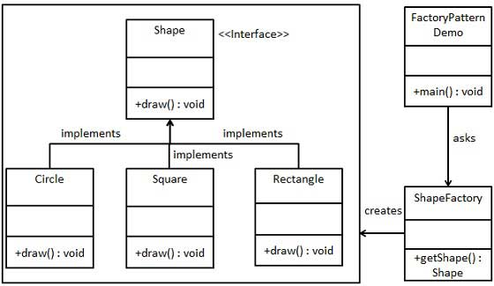
Design Patterns
Factory Design Pattern

Slide 6
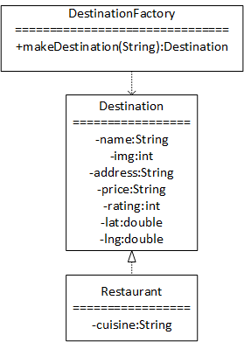
Design Patterns
Factory Design Pattern

Slide 7
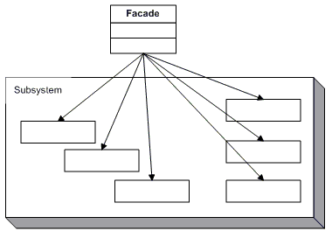
Design Patterns
Façade Design Pattern

Slide 8
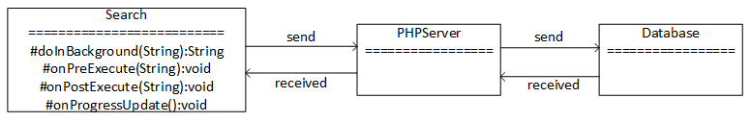
Design Patterns
Façade Design Pattern

Slide 9
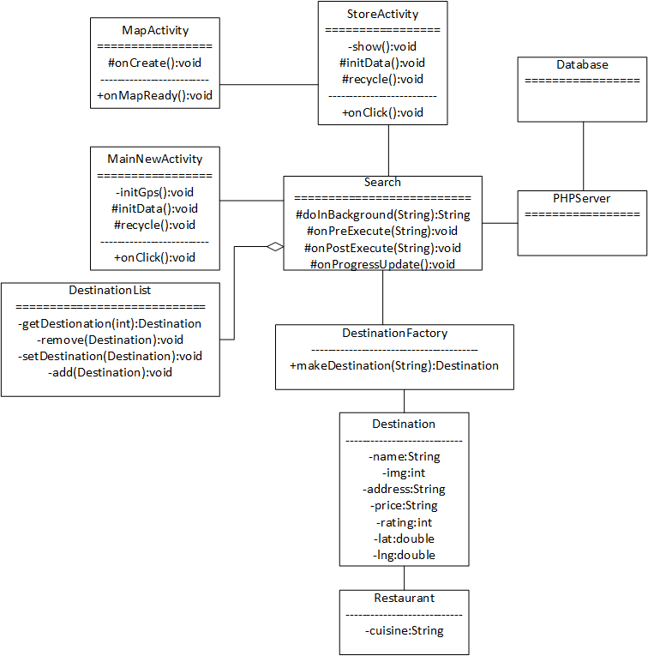
UML Class Diagram

